Slide 1
An intelligent pothole & hump detection and warning system for automobile applications
Ankit das
20MT3EP13
Presentation – 9/11/2022

Slide 2
Motivation
One of the major causes for road accidents in Indian roads is due to the potholes and humps. In this digital era, it becomes essential to identify and report these potholes to the corresponding authorities in an automated version.
So, therefore I want to propose a simple IoT based low-cost portable and economically affordable device to detect the potholes and intimate the damaged scenario to the corresponding authorities.
This project aims at identifying the potholes using image processing technology with the help of a camera. The system sends the location of these potholes to authorities using GPS, The humps are detected using the ultrasonic sensors and the electronics system alerts the driver about the humps. The alert is provided in the form of voice through speakers and displayed on the LCD and using GSM, SMS is sent to the driver.

Slide 3
introduction
The key problems and difficulties the road transport network faces are small roads, low road quality.
Road transportation has expanded exponentially over the last two decades with a huge boom in highway transportation, city transportation and even in villages, linking all corners of the world. Around 40% of the village roads doesn’t makeup to the level even to receive a star, which is marked as unsafe for the users.
Pothole formation has given rise to accidents and loss of human lives. Various techniques like image and videography analysis along with laser spectroscopy-based techniques have been implemented earlier in the literature to find the pothole and to provide information about the road depth, size, volume of the pothole, and pothole shape as well. This will provide a suitable maintenance measure which can be retrieved periodically.
Image processing techniques are used in to sense the exact pothole location .the potholes and obstacles on the road are identified using Ultrasonic sensors, and the detected pothole’s depth is displayed on the LCD.

Slide 4
objective
The objectives of the proposed work are:
Design and Development of the Pothole and hump detection System.
Help Road maintenance, aiding economic growth.
Avoidance of accidents via real time alerts through GSM.
To display the pothole location with latitude and longitude and time.

Slide 5
The components for the schematic
A. Raspberry Pi Pico: a new tiny member to the Raspberry Pi family, Raspberry Pi Pico. Pi Pico is a micro-controller board based on in-house custom designed chip (RP2040) by Raspberry Pi in the UK. RP2040, the chip at the heart of Pico, is an ultra powerful Dual Core ARM Cortex-M0+ clocked at 133MHz with 256KB RAM, 2MB of on-board QSPI Flash memory for code and data storage. It also has 30 GPIO pins and lots of interfacing options including 2 × SPI, 2 × I2C, 2 × UART, 3 × 12-bit ADC, 16 × controllable PWM channels. Moreover, 26 of the GPIO pins are multi-function, which means we can configure those pins to a different behaviour like UART/I2C/SPI/GPIO
B. Ultrasonic Sensor HC-SR04: HC-SR04 sensor is a 4-pin module, whose pin names are Vcc, trigger, echo and ground respectively. The sensor uses a regulated +5V through the Vcc and ground pins of the sensor. To measure, the trigger pin is to be made high for 190μs and then turned off . This action will trigger an ultrasonic wave at frequency of 40Hz from the transmitter and the receiver will wait for the wave to return. The wave returns after getting reflected by any object, the echo pin goes high for a particular amount of time which will be equal to the time taken for the wave to return back to the sensor. The amount of time during which the Echo pin stays high is measured by the MCU as it gives the information about the time taken for the wave to return back to the Sensor. This sensor measures the distance of the hump which is present in front of it. The sensor works with the formula: Distance=Speed × Time.To use the above equation we should know the speed and time. Speed of Ultra Sonic (US) wave is 330m/sec.

Slide 6
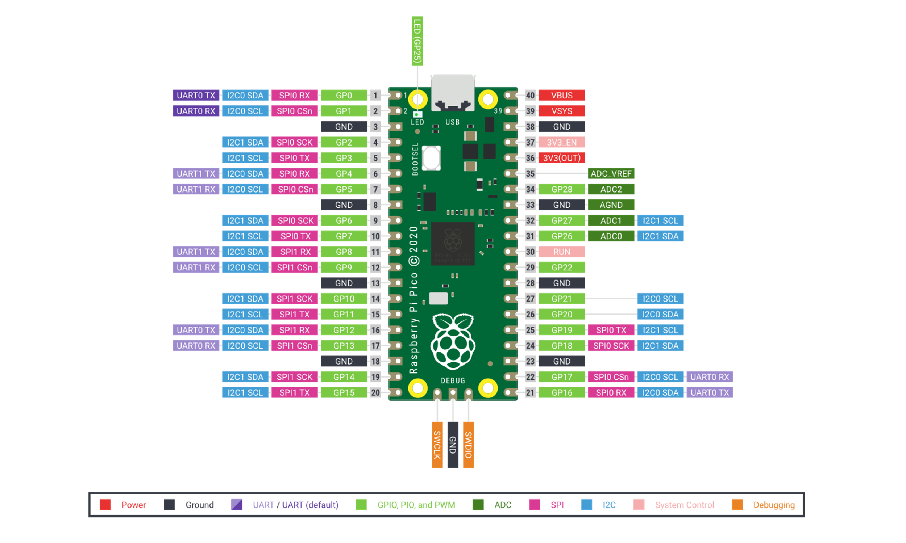
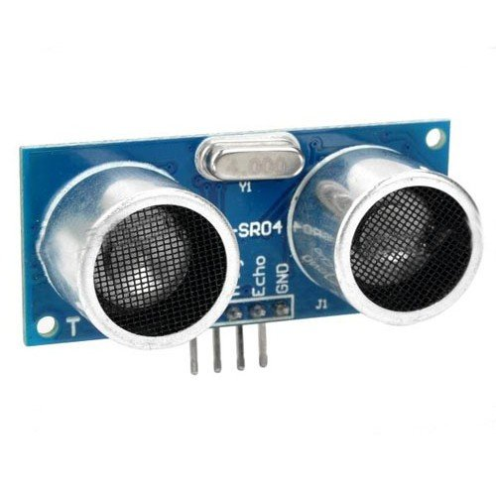
Raspberry PI pico and ultrasonic sensor

Slide 7
C. LCD (16x2) : LCD (Liquid Crystal Display) screen (Fig. 4) is an electronic display module. A 16×2 LCD can display 16 characters per line and there are 2 such lines. In this project it is used to provide display of hump and porthole to car driver.
D. Camera: A webcam is a video camera that feeds or streams image in real time to or through a computer to a network. The term "webcam" may also be used in its original sense of a video camera connected to the Web continuously for an indefinite time, rather than for a particular session, generally supplying a view for anyone who visits its web page over the Internet. In this project the pothole images are taken by the web camera and sent to Raspberry Pi Pico for processing,

Slide 8
F. Relay (JQC-3FC (T73) DC12V): A relay is an electrically operated switch. Relays are used where it is necessary to control a circuit by a separate low-power signal, or where several circuits must be controlled by one signal.
G. GPS Sensor: The NEO-6M GPS module is a GPS receiver that can locate all locations on Earth as it is able to track approximately 22 satellites. It consists of a high-performance u-blox 6 positioning engine. Measuring 16 x 12.2 x 2.4 mm, its compact architecture along with its low power consumption makes it a good choice for IoT projects. Overall it is a good cost-effective GPS receiver. In the middle of the GPS module, you can find the NEO-6M chip. This is responsible for tracking up to 22 satellites and any location on the Earth on several channels. Due to its highly sensitive tracking nature, it makes the NEO-6M module a popular GPS tracker.

Slide 9
System design and development
The pothole and hump detection system development is as shown in figure next slide. It makes use of Raspberry Pi Pico as the central processing unit, receives the data inputs through sensors and processes it and takes action of sending alerts, display and messaging to the vehicle drivers.
LCD, Sensor, Relay are interfaced to Raspberry Pi Pico. . Raspberry Pi Pico gathers data about potholes and humps and geographical position of potholes and this data is transmitted to the server. The data of geographical position received is processed and stored. The information stored in the database provides timely alerts to the driver about potholes along with geographical position.

Slide 10
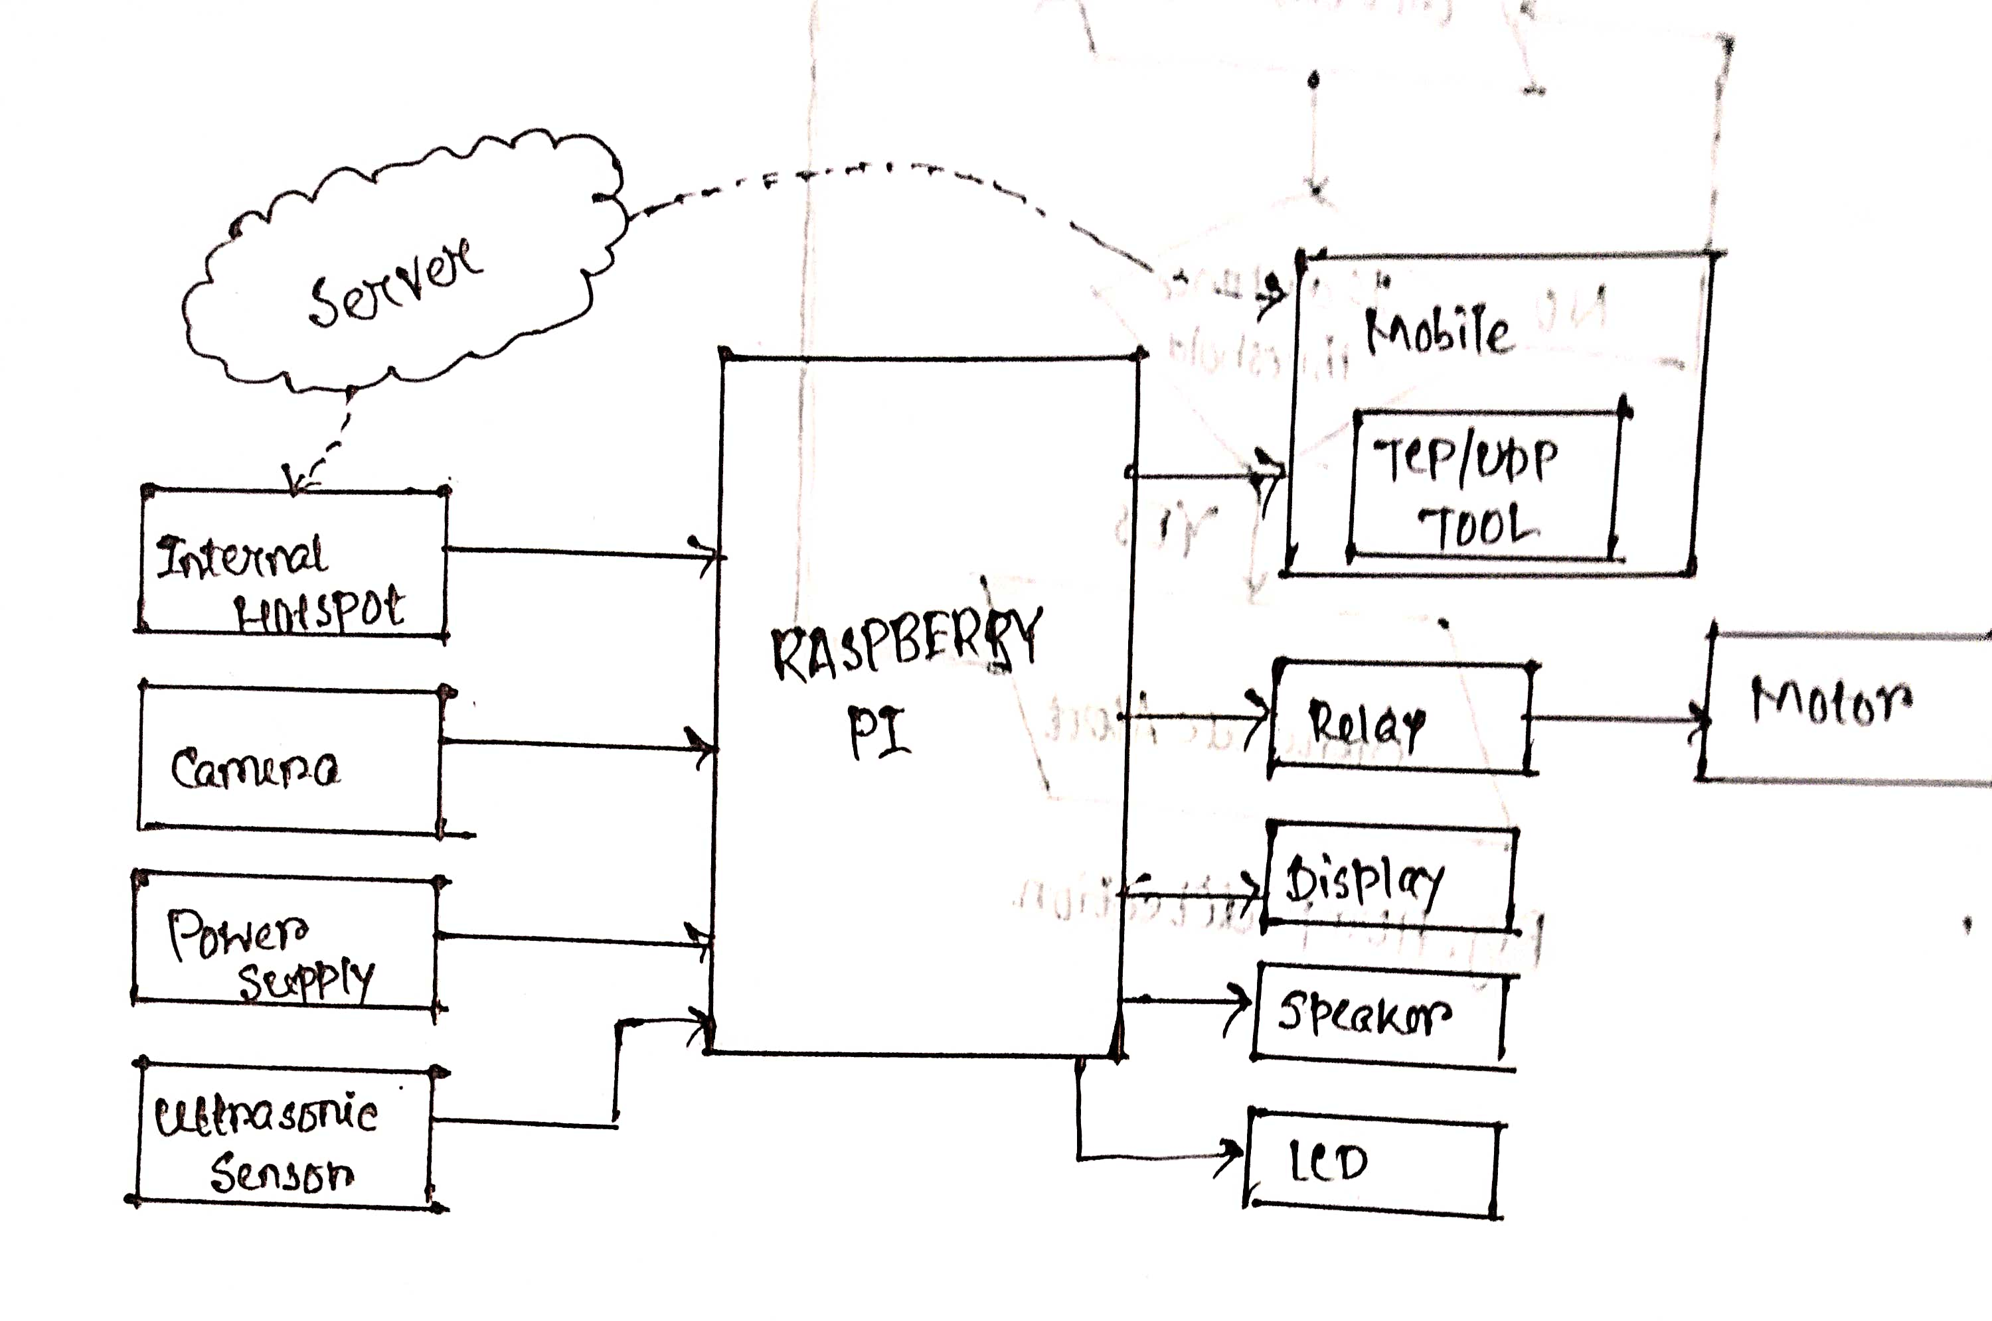
Block diagram

Slide 11
methodology
A. Pothole Detection: The location of the vehicle is tracked using GPS module. The camera captures the image of the road continuously through OpenCV in RGB form.
OpenCV uses the BGR format instead of RGB.
Then it converts the image from RGB form to GRAY by image processing technique. It is then dilated for image enhancement of the concentrated region.
The obtained image is then compared with the stored pothole reference image in the database.
If, the captured image matches with stored image in the directory , then the Raspberry Pi Pico sends the location of the pothole to the authorities through LCD display along with the real time and the number of potholes, their danger level I.e. S, A, B, C.
. It also generates alert to the driver through LCD display and speaker that a pothole is detected. This process is repeated. The above mentioned process can be understood as shown in the flow chart

Slide 12
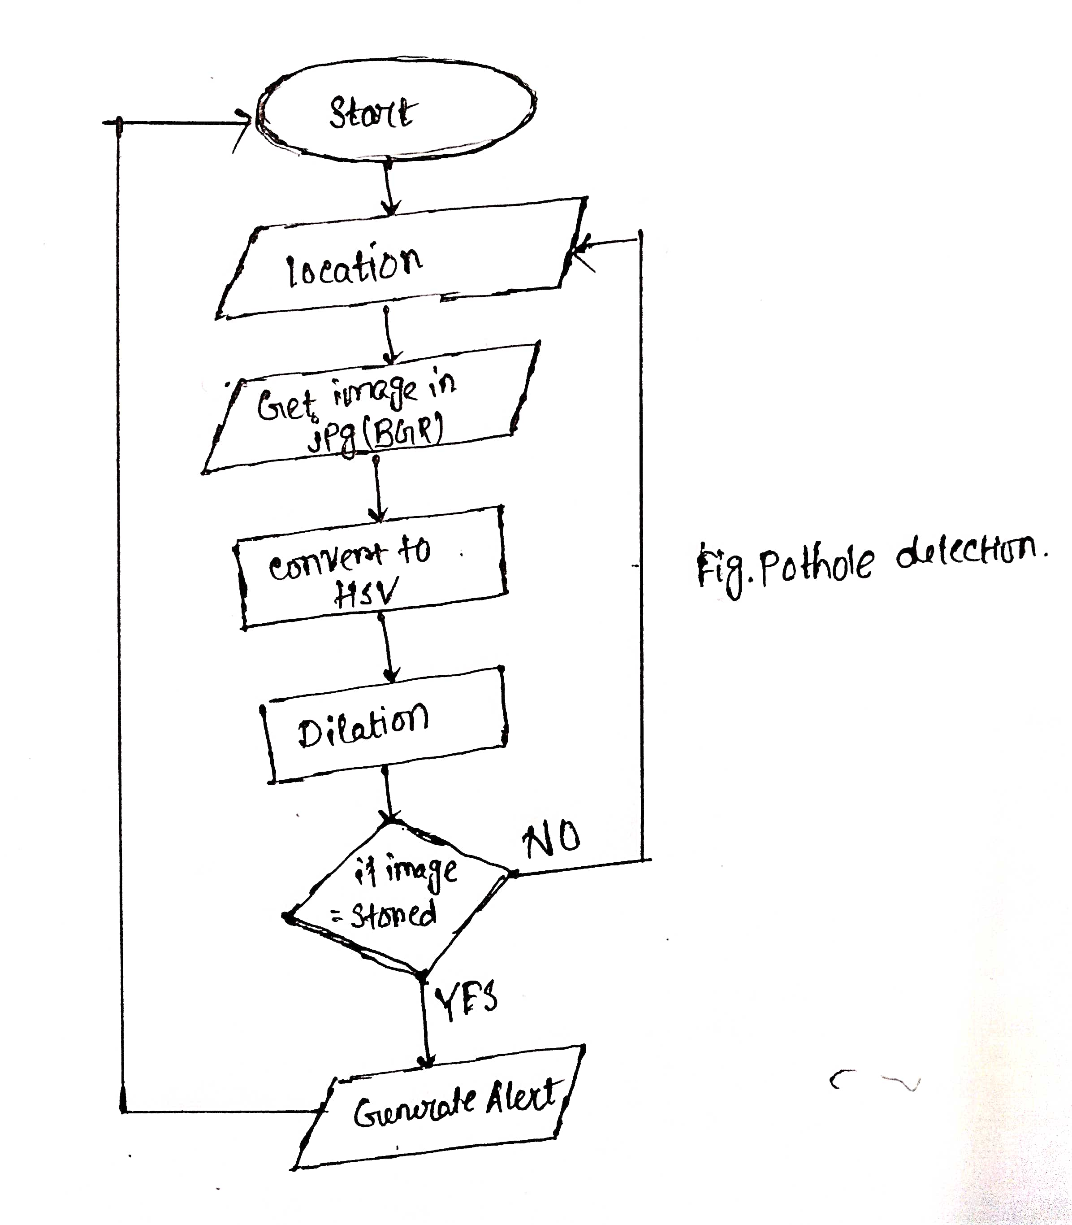

Slide 13
Hump detection
The ultrasonic sensor regularly measure the distance between the vehicle and the road. The distance is compared with the set threshold.
When the distance is lesser than the set threshold it generates an alert to the driver through LCD. This process is repeated and is as shown in the flow chart as shown.

Slide 14
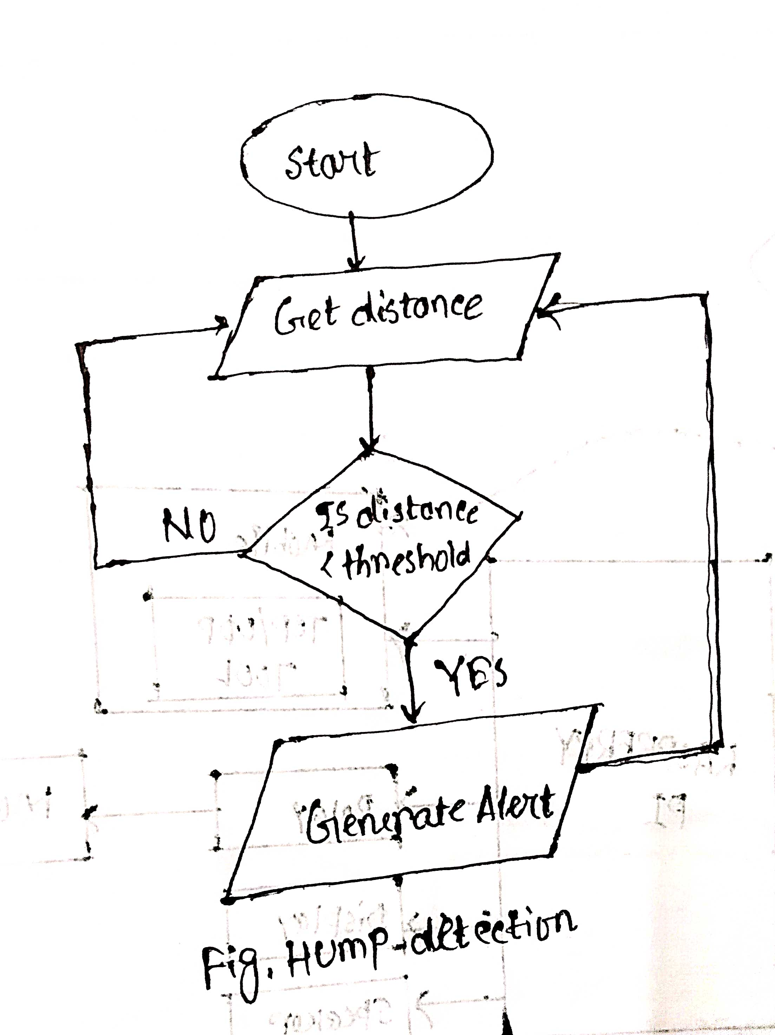

Slide 15
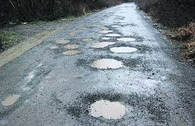
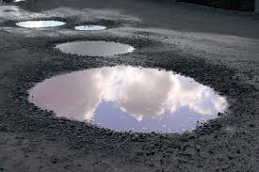
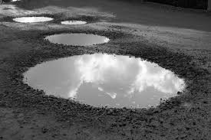
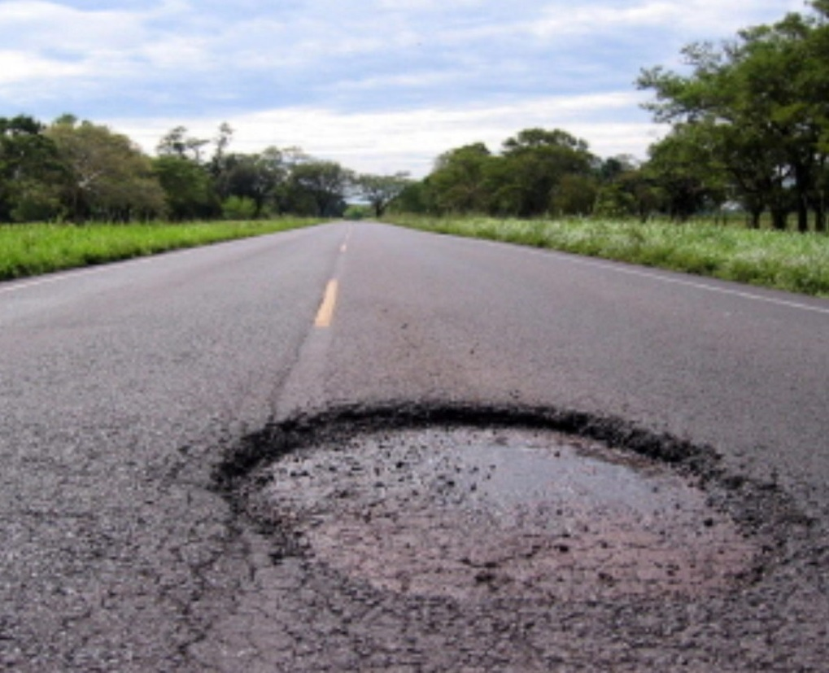
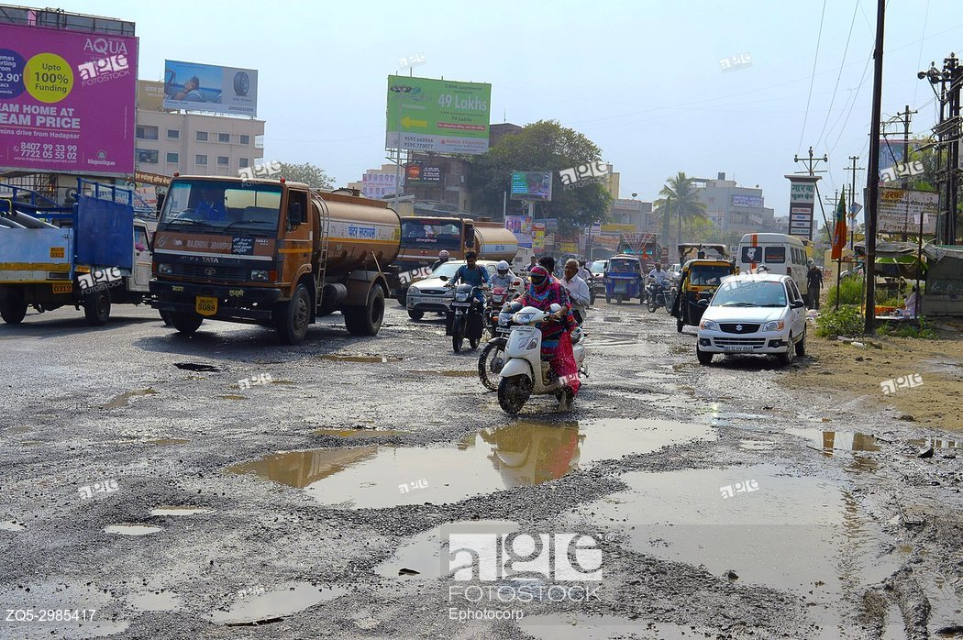
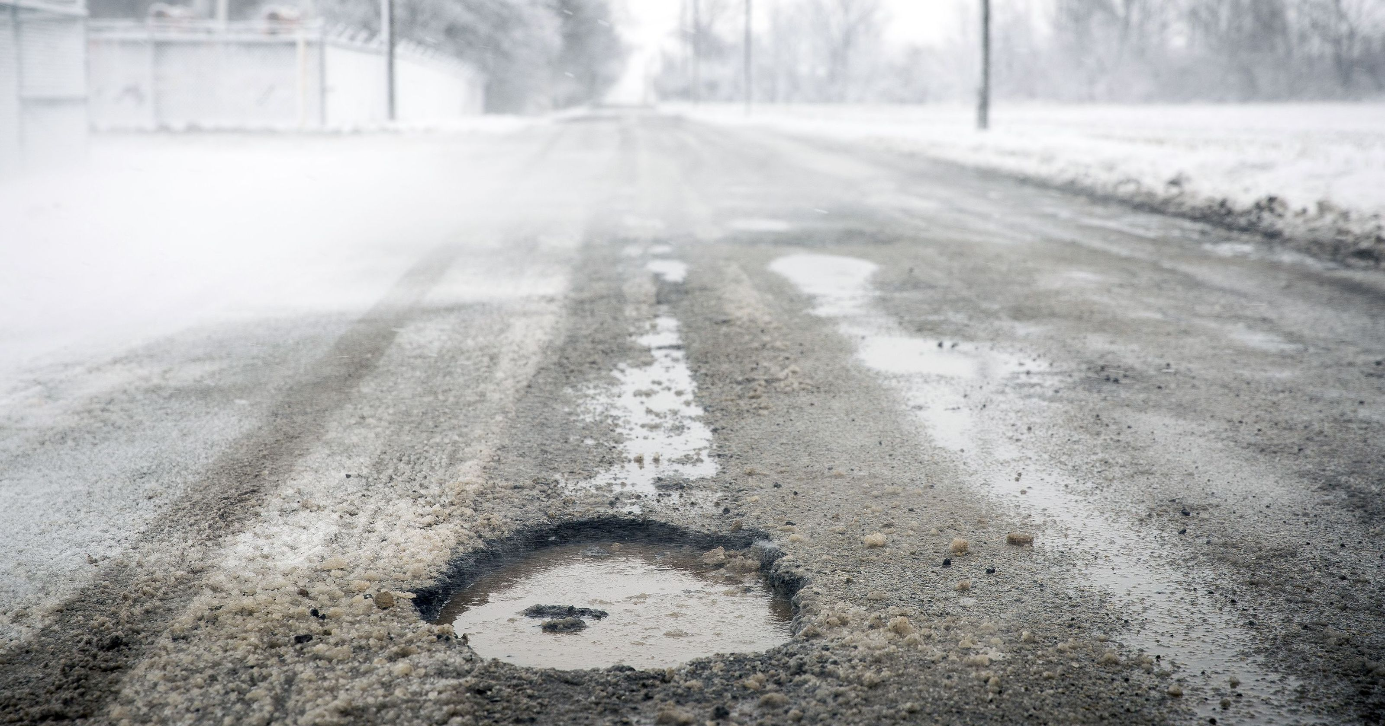
Some images from dataset (obtained from kaggle.com)

Slide 16
Pothole Detection:
First of all , we download unified dataset for pothole images with or without pothole images and the dataset.csv file with information and image Id of the images, no. Of potholes and danger levels.
We processed the csv file and read from it with pandas library.
We looked into the basic preparation techniques like NaN type value handling in columns, getting dummy variable of a binary or categorical variables and lastly statistical shuffling for further processes.
For the data modelling and model fitting with prediction purposes we split the data as usual as train test split with sklearn.model_selection class method train_test_split with 30% data for testing purposes.
We defined a function to get the access by file_location from the Image_Id of Dataset.csv from the Unified Dataset and with OpenCV library made the image as Gray from RGB format.

Slide 17
Pothole detection (contd.):
From 0 to 255 range the gray images are normalize on the scale of (0,1) with Min_Maxscaler of sklearn.
Next, the images pothole_or_not, pothole_number, pothole_level are converted to numpy arrarys along with the garay image pixels.
Now we define a class My_Custom_Generator with inheriatance from keras.utils.Sequence inbuilt keras class and defined batch size batch number and accessing the image file fro directory.
We now define the batches as train and validation set divider and start doing the modelling.
With 2D convolution, I used the other keras layers of Dense, Flatten, MaxPooling2D, Dropout, Input etc. With different neural network functionality and architecture. The total architecture model for this prototype is shown in the next slide.

Slide 18
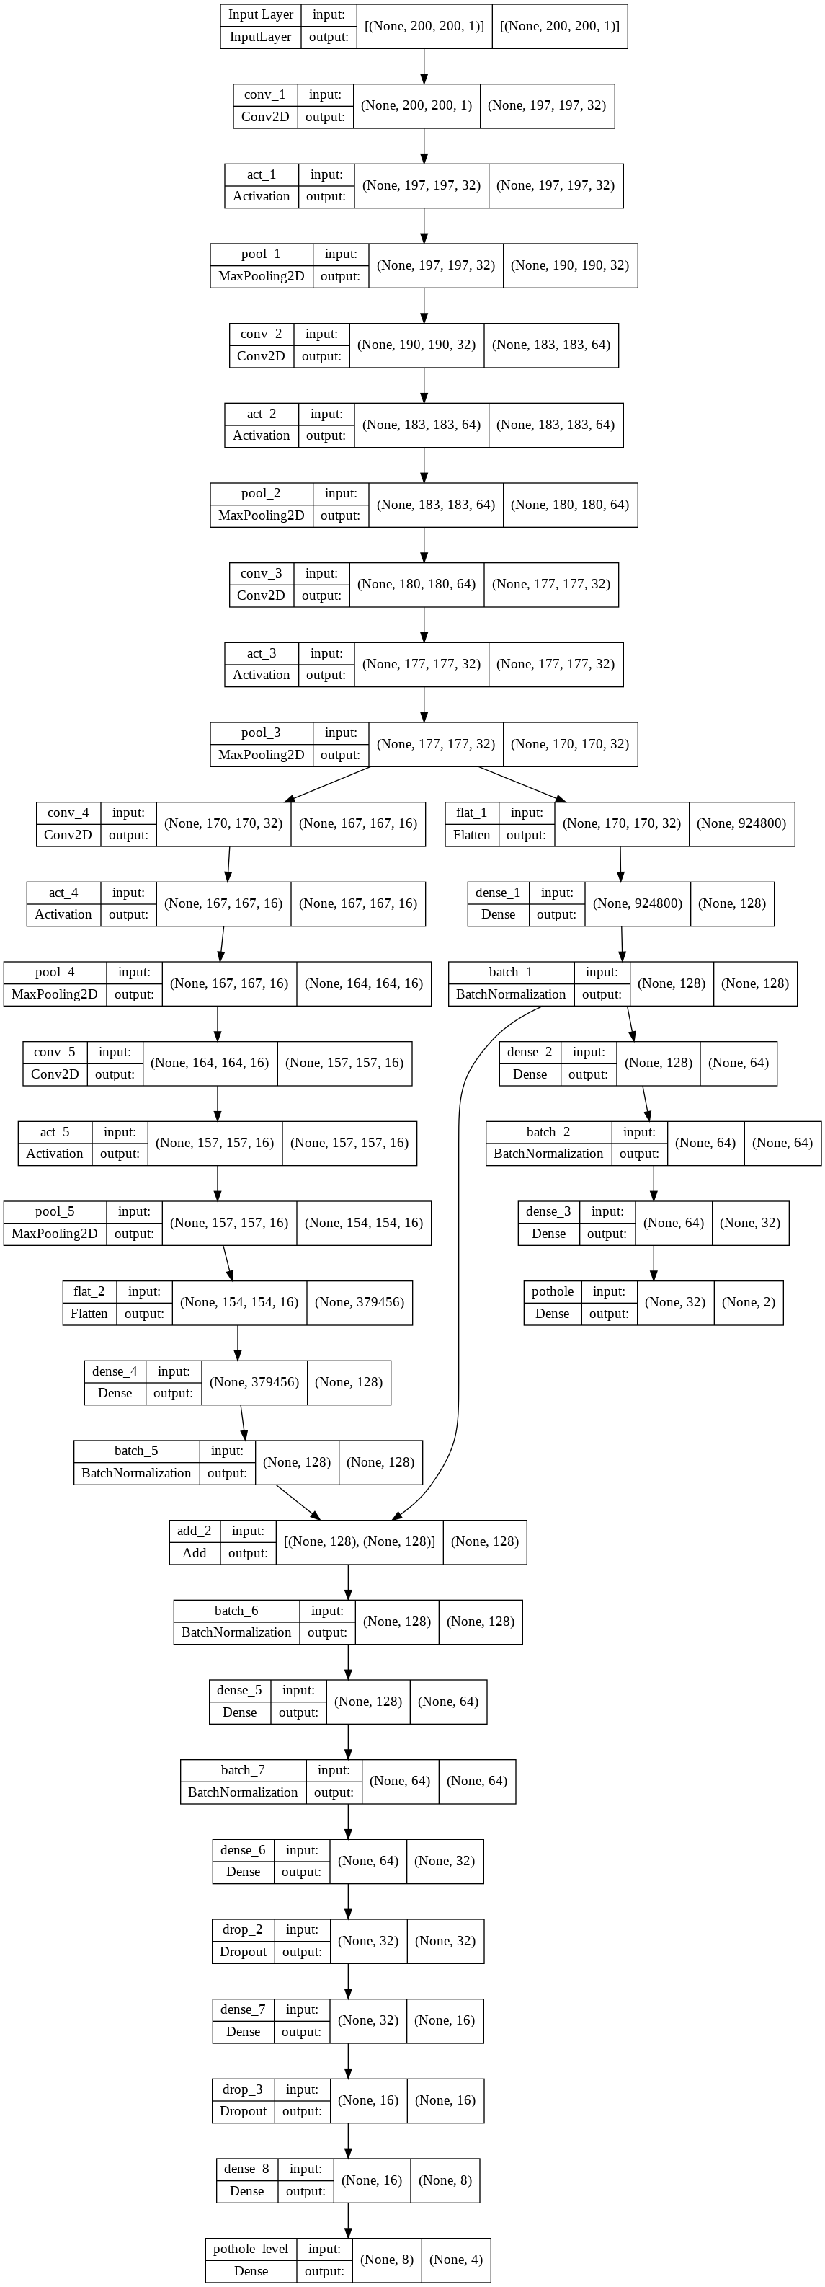
Model architecture for pothole detection

Slide 19
Pothole detection (contd.):
Next process, I started fitting the training set batchwise with model.fit_generator function with the defined 'model', and started doing validation set testing and model_accuracy was determined with accuracy_score.
Now we just started fitting and predicting the test data that was separated from the training set.
From the WebCamCapture.py file I started doing the image capturing with webcam and the files are stored in the directory as the "Saved_Image.jpg" and every time image is captured the file name gets replaced by the new image. The image is then preprocessed and fitted and predicted with the existing model.
No. Of potholes, pothole or not and danger level of pothole is determined from the prediction and if there is a pothole the GPS function is enabled and real time and along with latitude and longitude of the position is mentioned.
The codes of the above process is being shared.

Slide 20
Ultrasonic sensor based Hump detection
Hardware
HC-SR04 Module
Resistors: 330Ω and 470Ω
Jumper wires
There are four pins on the ultrasound module that are connected to the Raspberry:
VCC to Pin 2 (VCC)
GND to Pin 6 (GND)
TRIG to Pin 12 (GPIO18)
connect the 330Ω resistor to ECHO. On its end you connect it to Pin 18 (GPIO24) and through a 470Ω resistor you connect it also to Pin6 (GND).

Slide 21


We do this because the GPIO pins only tolerate maximal 3.3V. The connection to GND is to have a obvious signal on GPIO24. If no pulse is sent, the signal is 0 (through the connection with GND), else it is 1. If there would be no connection to GND, the input would be undefined if no signal is sent (randomly 0 or 1), so ambiguous.
First of all, the Python GPIO library should be installed
To use the module, we create a new script
Ultrasonic_bump_detection.py
from machine import Pin import utime trigger = Pin(14, Pin.OUT) echo = Pin(15, Pin.IN) def ultra(): trigger.low() utime.sleep_us(2) trigger.high() utime.sleep_us(5) trigger.low() while echo.value() == 0: signaloff = utime.ticks_us() while echo.value() == 1: signalon = utime.ticks_us() timepassed = signalon - signaloff distance = (timepassed * 0.0343) / 2 print("The distance from object is ",distance,"cm") while True: ultra() utime.sleep(1)

Slide 22
Inferences:
The sample study indicated a precision of 86.8% and recall of 84.4%. It was also found that the algorithm rejected vehicles on the road 80% of cases (5 frames contained vehicles, and a vehicle was classified as a pothole in only 1 frame). It is possible to increase this accuracy by increasing the dilation process by several factors; however, this will lead to a loss of pothole detection, as more potholes likely merge with the outer road contour.
Precision = TP/(TP+FP)
Recall = TP/(TP+FN)
Due to the nature of the algorithm it was also determined that in the event that two potholes are closely spaced together, they would be grouped together and seen as a single contour. This was mostly the case with potholes that were further away from the vehicle. As the vehicle moved closer, the potholes eventually separate far enough from each other that they can be identified as individual potholes.

Slide 23
conclusion
The paper presented a preliminary method for pothole detection using a single optical camera that can detect potholes within a range of ≈ 2 m - 20 m. It was found that the method works relatively well in discarding other vehicles although further research must be performed to improve this aspect. By measuring the time it takes to perform the algorithms, it was found that the algorithm execution speed is adequate given a vehicle speed of less than 60 km/h although the actual maximum distance at which the pothole can be detected needs to be improved to account for the driver reaction time. The algorithm is successful in the detection of potholes and an attempt will be made to upgrade it to include potholes with no visible edges (due to sand or dirt) in future research. The new and advanced techniques of image processing like YOLOv4 and DARKNET can be used for more precision and accuracy (over 90% maybe).

Slide 24
References:
Bradski, G. & Kaehler, A., 2008. In: Learning OpenCV. California: O'Reilly Media Inc., p. 154.
Buza, E., Omanovic, S. & Huseinovic, A., 2013. Pothole Detection with Image Processing and Spectral Clustering. Antalya, Turkey, 2nd International Conference on Information Technology and Computer Networks.
OpenCV, 2014. The OpenCV Reference Manual Release 2.4.9.0. [Online] Available at: docs.opencv.org/opencv2refman.pdf [Accessed 12/10/2022].
Danti, A., Kulkarni, J. & Hiremath, P., 2012. An Image Processing Approach to Detect Lanes, Pot Holes and Recognize Road Signs in Indian Roads. International Journal of Modeling and Optimization, 2(6), pp. 658-662.
Szeliski, R., 2011. Computer Vision - Algorithms and Applications. London: Springer.

Slide 25
Thank you!!

